Slide 1
User Interface and Data Management
ISIS scientific computing strategy away day

Slide 2


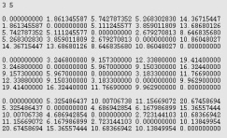

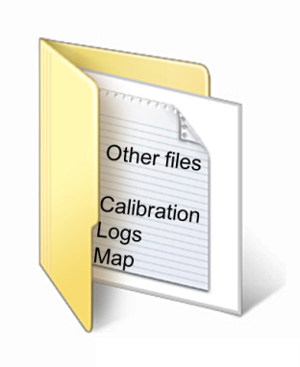
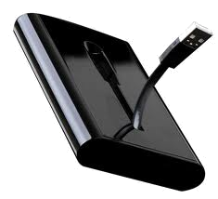


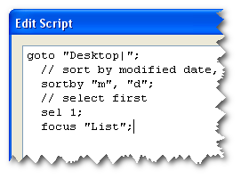

Current situation
Data
Notes:
require all their data on a local machine.
downloading large datasets across the Janet network is very time consuming.
calibration data and log files and map files.
reduction scripts and other bits and bobs.
need to remember how to use the application.
Users are busy and have other things to do
This strategic vision for the project is to produce a framework that maximises the time spent actually performing data analysis, and minimises the time setting the framework up. To present the user with a common and flexible framework that allows efficient and timely publication of ISIS data.

Slide 3
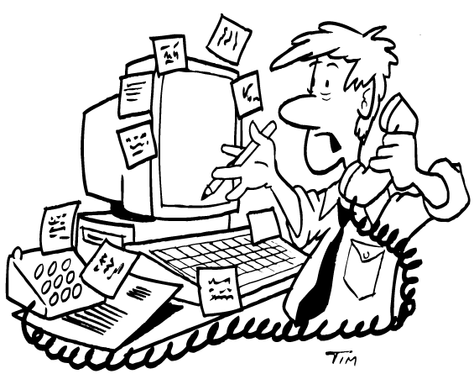
Current situation
Notes:
require all their data on a local machine.
downloading large datasets across the Janet network is very time consuming.
calibration data and log files and map files.
reduction scripts and other bits and bobs.
need to remember how to use the application.
Users are busy and have other things to do
This strategic vision for the project is to produce a framework that maximises the time spent actually performing data analysis, and minimises the time setting the framework up. To present the user with a common and flexible framework that allows efficient and timely publication of ISIS data.

Slide 4
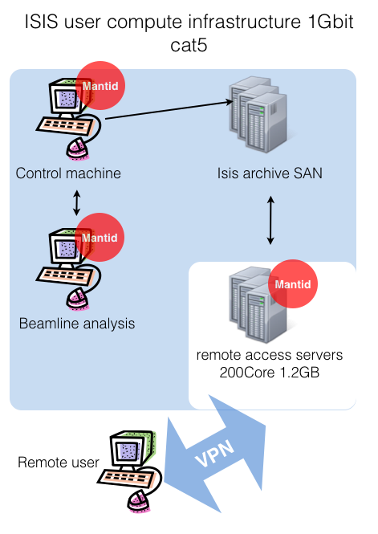
Current high Volume data
users need to:
  Use SSH
  Use VNC
  Use VPN
  federal ID and password
Also 3D views will not work well

Slide 5
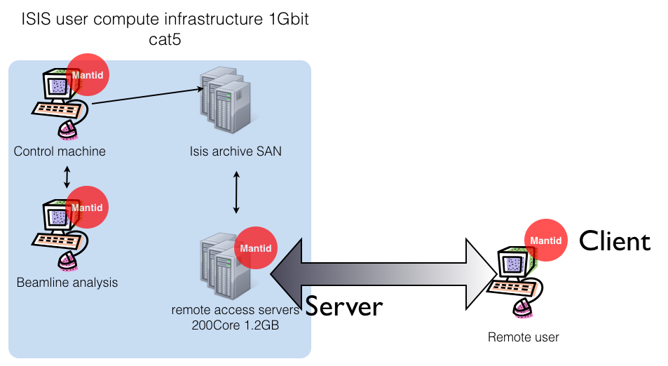
A possible solution

Slide 6
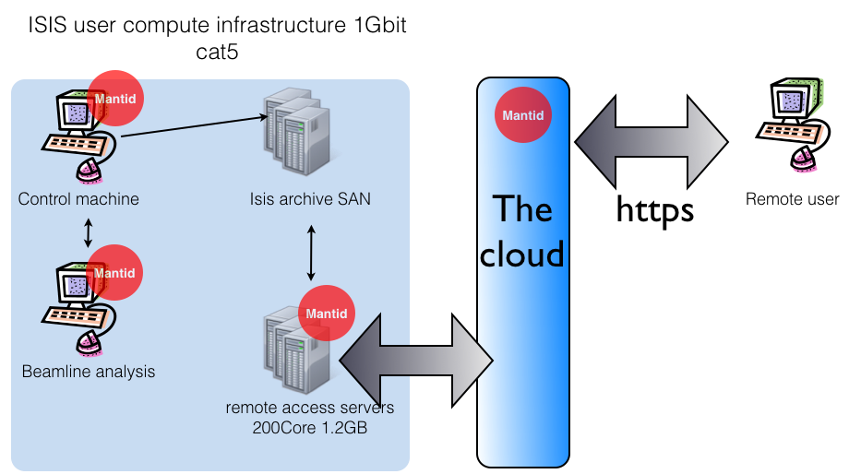
Web data access and reduction?

